Slide 1
Presentation
MST DENIM COLLECTION

Slide 2
MENS COLLECTION

Slide 3
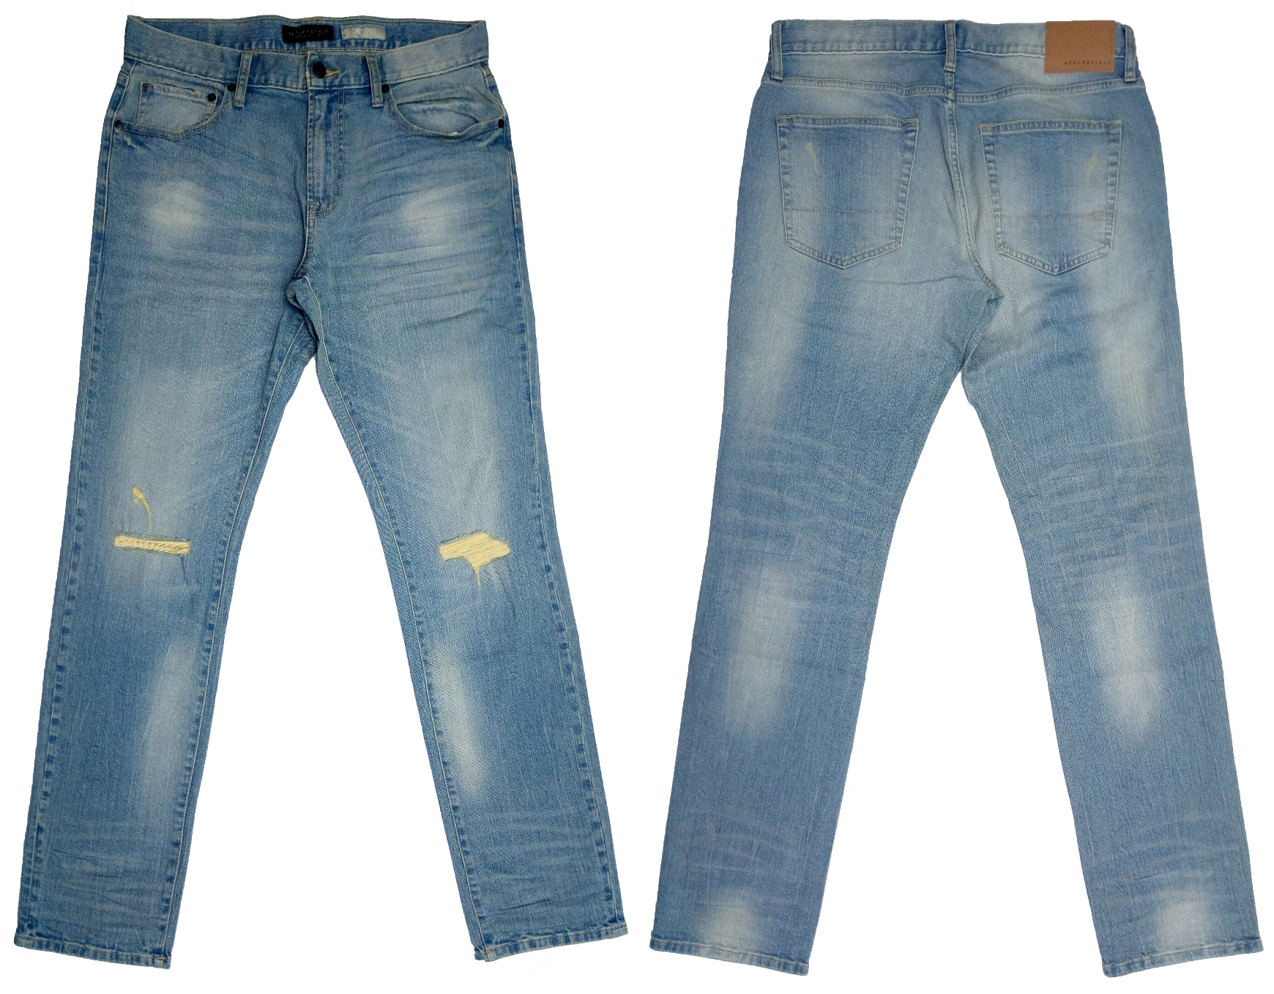
Buyer : AEROPOSTALE
Brand : AEROPOSTALE
Style : 1350
Fabrication : 98% Cotton 2% Spandex . Fab prx: $3.15/yds
Wash : Enzyme, Bleach With Dry Process & Rip FOB: $9.35

Slide 4
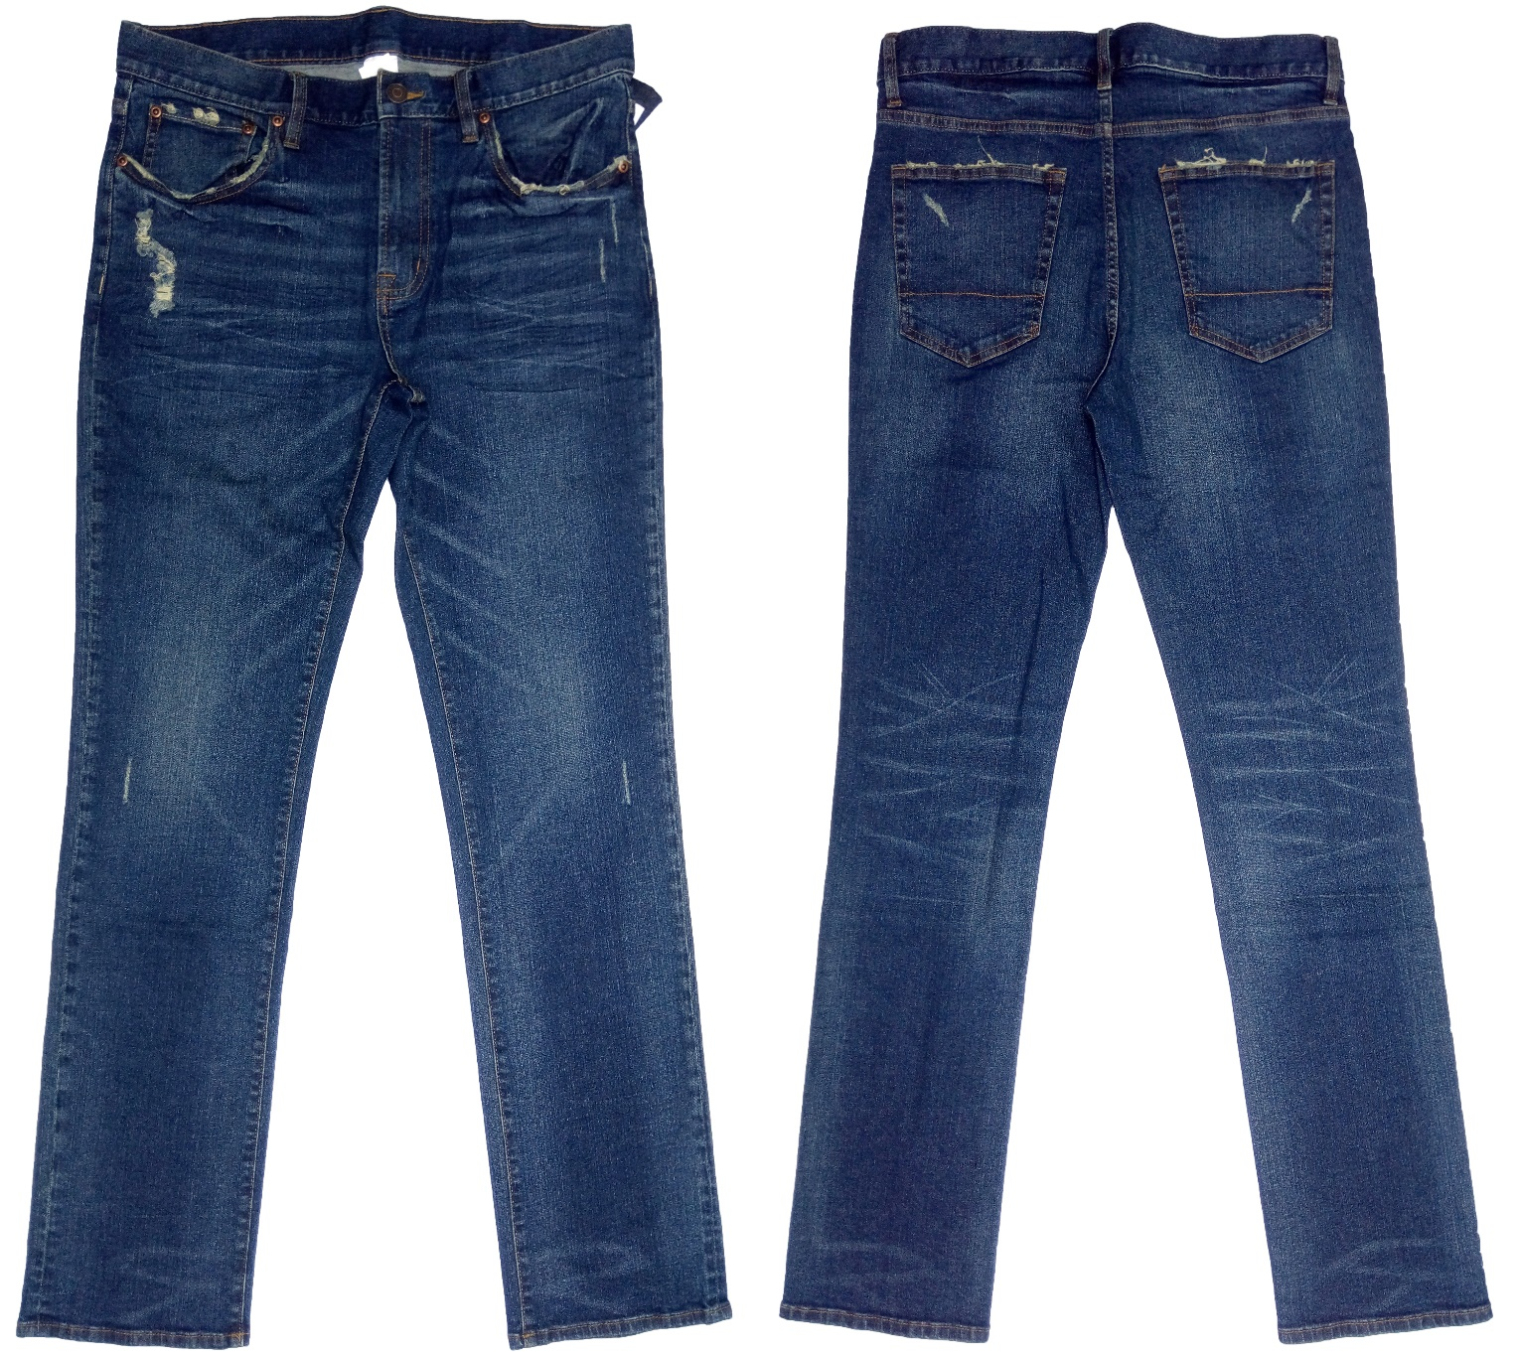
Buyer : : AEROPOSTALE
Brand : : AEROPOSTALE
Style : 1342
Fabrication : 98% Cotton 2% Spandex fab prx: $3.15/yds
Wash : Enzyme, Bleach With Dry Process & Rip fob: $10.20

Slide 5
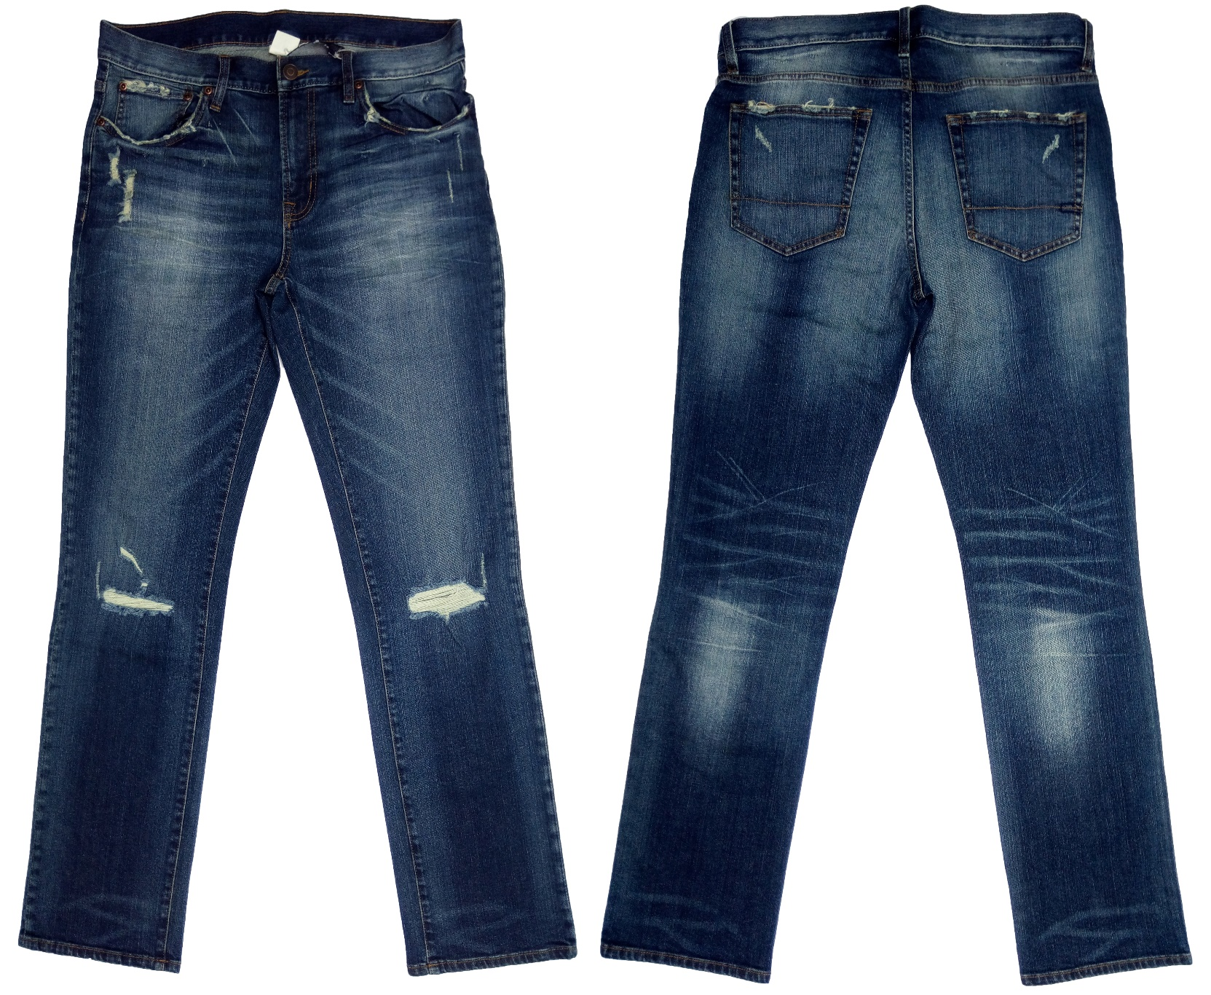
Buyer : : AEROPOSTALE
Brand : : AEROPOSTALE
Style : 1342 (Op-2)
Fabrication : 98% Cotton 2% Spandex FAB PRICE: $3.15/YDS
Wash : Enzyme, Bleach With Dry Process & Rip FOB: $10.45

Slide 6
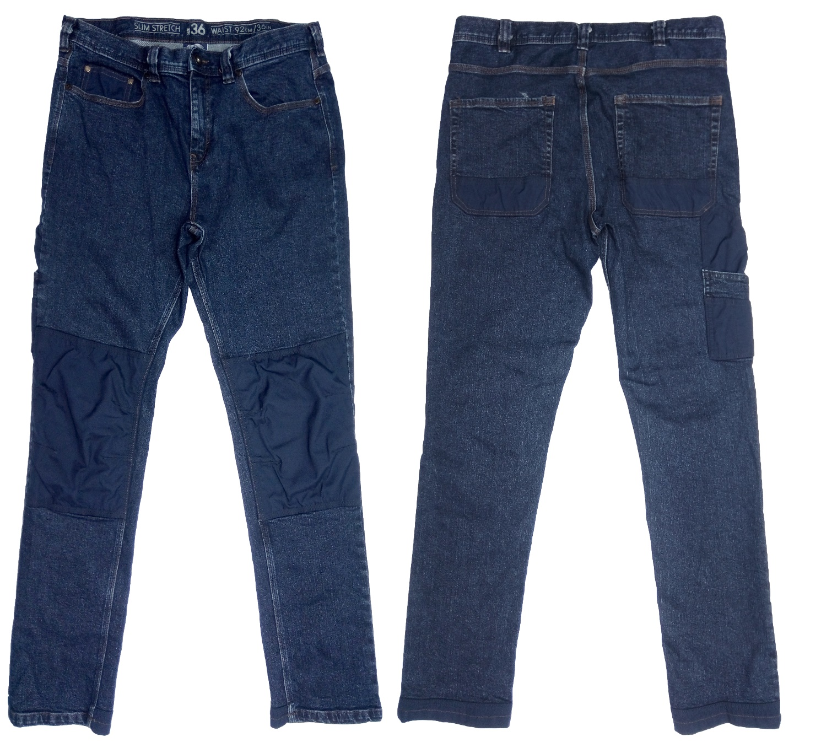
Buyer : K-MART
Style : 96NSWWWP012
Fabrication : 98% Cotton & 2% Spandex Denim. FAB PRICE: $2.35/YDS
Wash : Garments Wash + Dry Hand Feel. FOB: $8.90

Slide 7
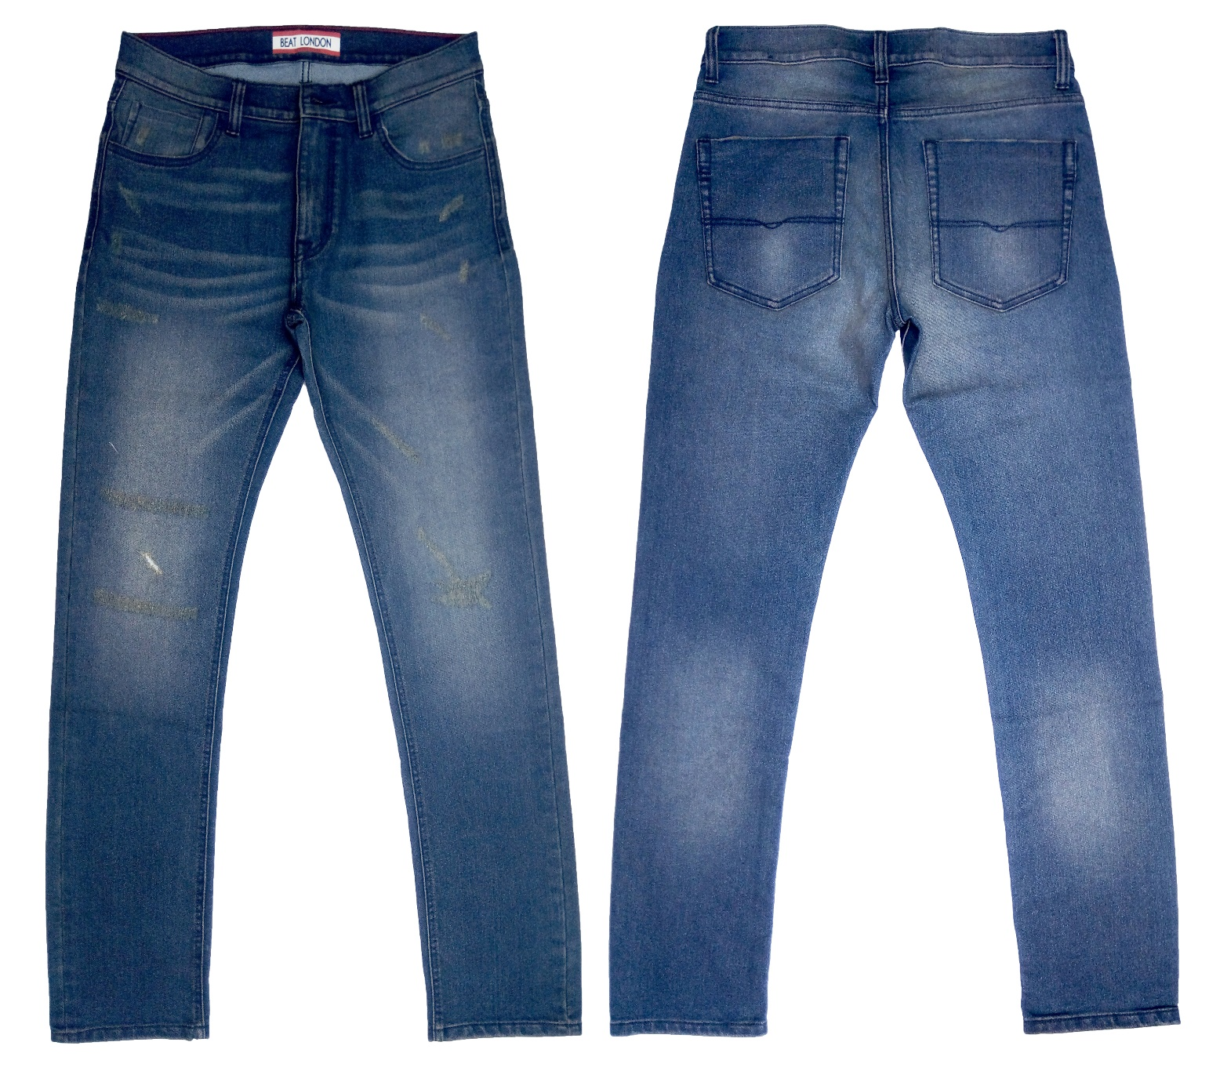
Buyer : PEPE JEANS
Brand : BEAT LONDON
Style : BL - OP07 – G (COS-1095)
Fabrication : 76% Cotton 22% Poly 2% Spandex Denim FAB PRICE: $2.30/YDS
Wash : Gesize, Enzyme, Bleach with Dry Process & Rip. FOB: $8.20

Slide 8
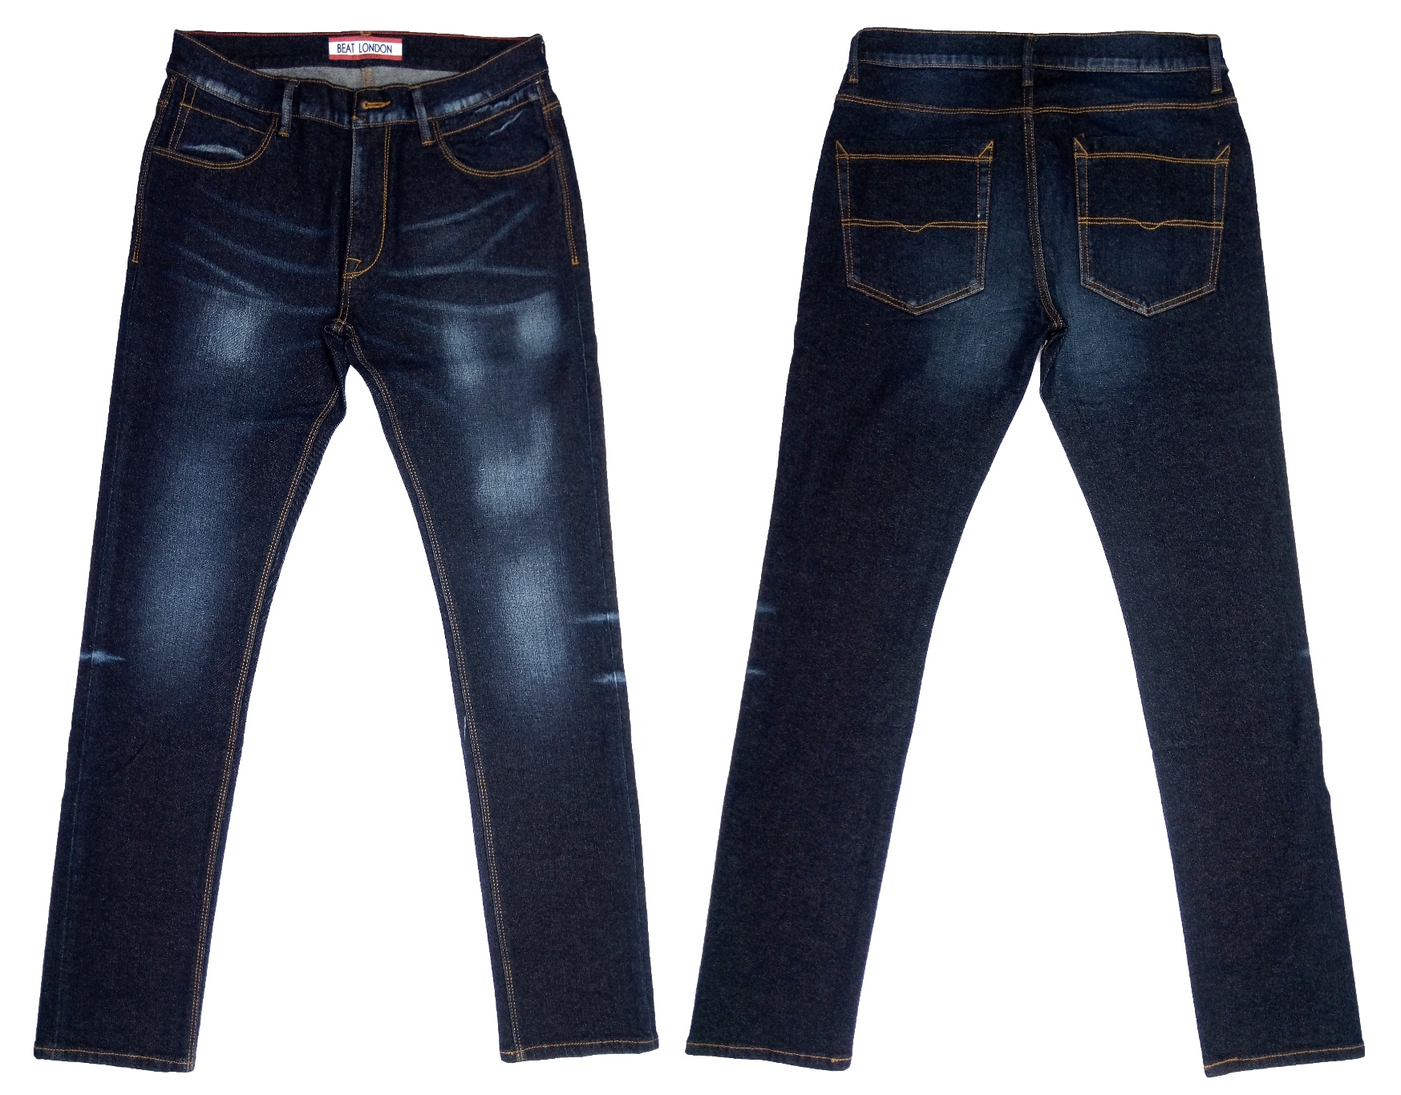
Buyer : PEPE JEANS
Brand : BEAT LONDON
Style : BL - OP04 BASIC – A (85850)
Fabrication : 99% Cotton 1% Spandex Denim FAB PRICE: $2.25
Wash : Gesize, Enzyme, Bleach with Dry Process FOB: $7.35

Slide 9
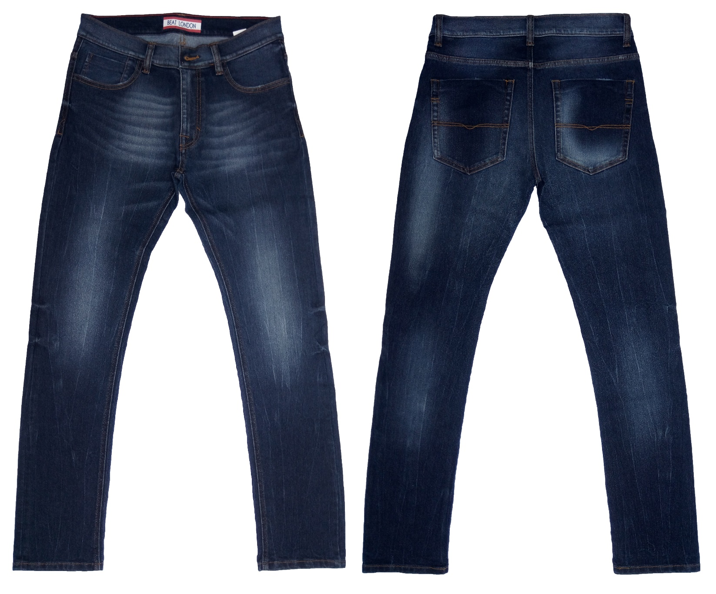
Buyer : PEPE JEANS
Brand : BEAT LONDON
Style : BL - OP07 – D (COS-1095)
Fabrication : 76% Cotton 22% Poly 2% Spandex Denim. FAB PRICE: $2.20
Wash : Gesize, Enzyme, Bleach with Dry Process. FOB: $ 7.65

Slide 10
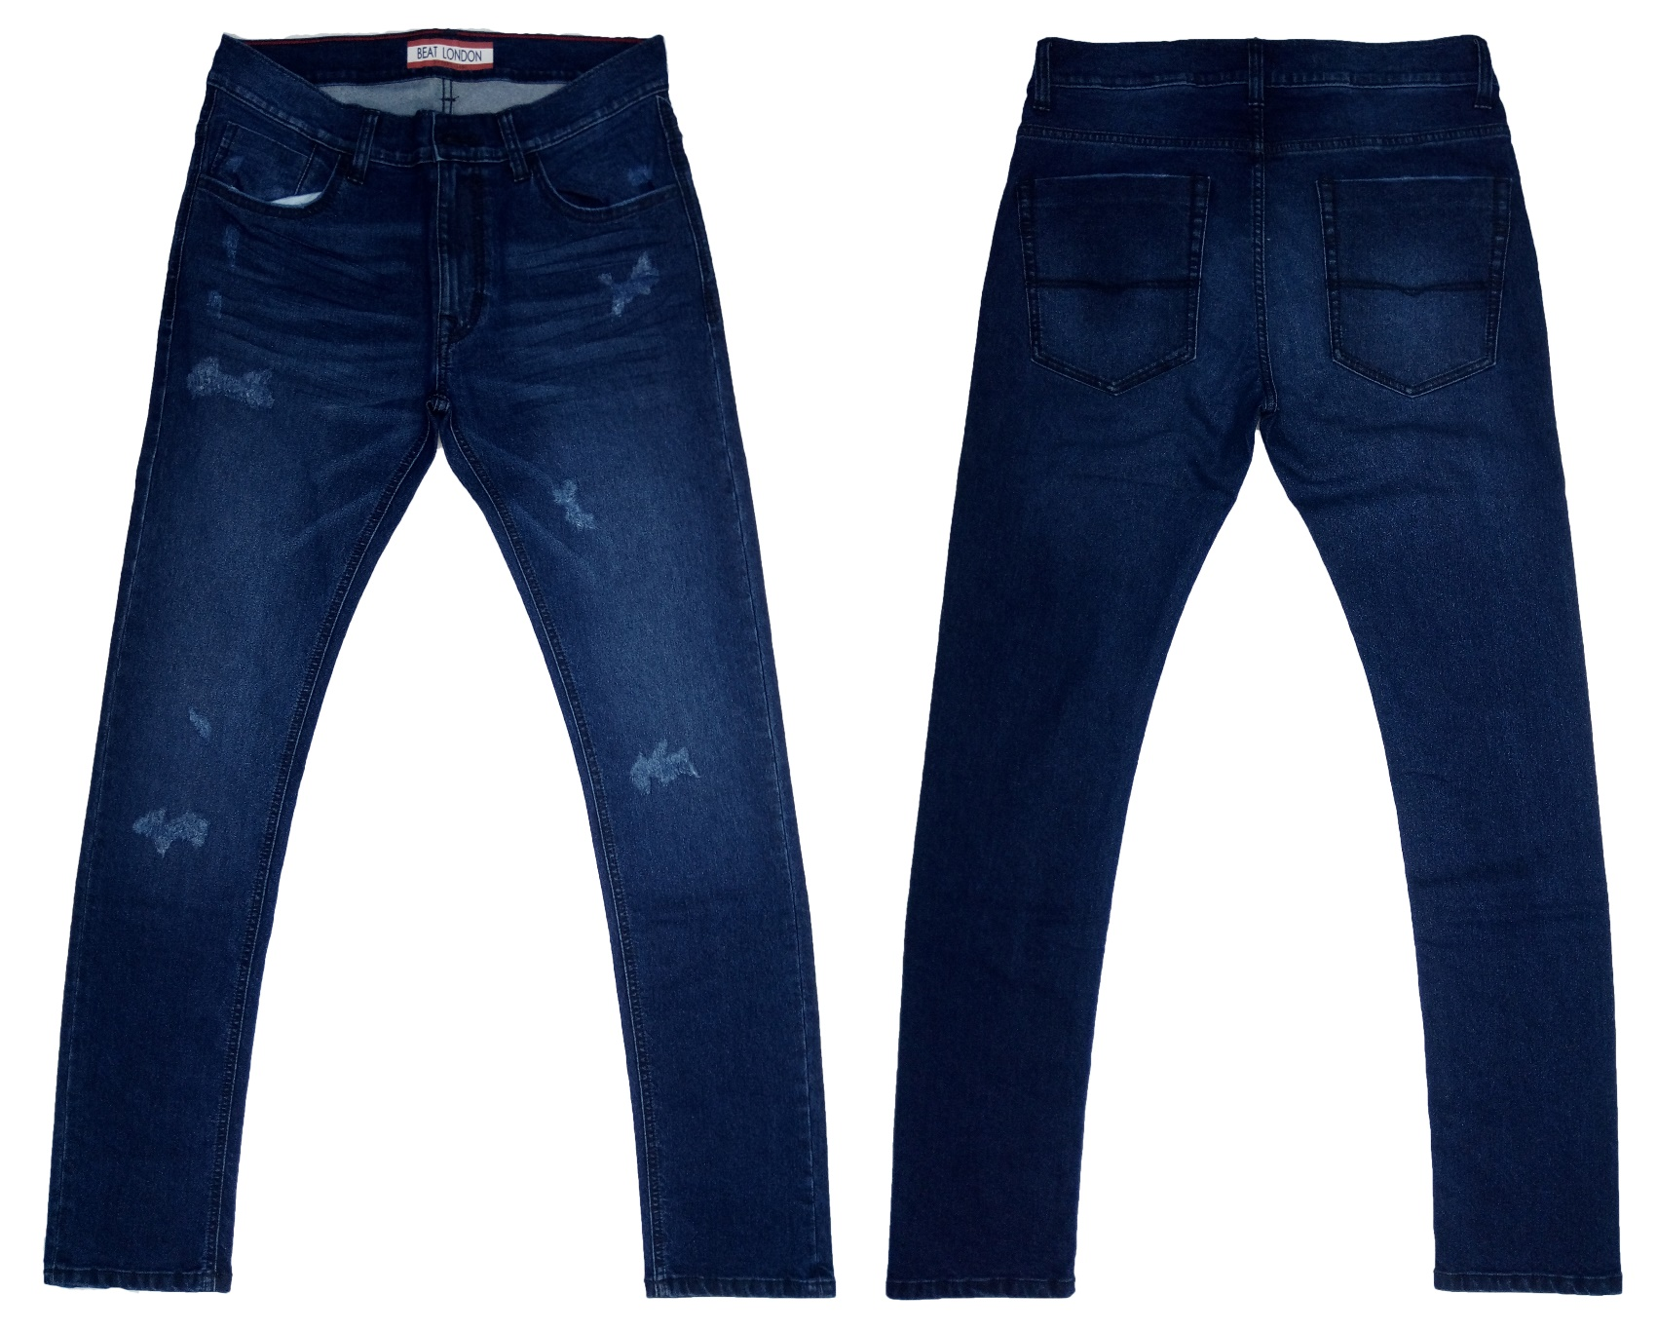
Buyer : PEPE JEANS
Brand : BEAT LONDON
Style : BL - OP07 – G (2407)
Fabrication : 76% Cotton 23% Poly 1% Spandex Denim FAB PRX: $2.35/YDS
Wash : Gesize, Enzyme, Bleach with Dry Process & Rip FOB: $8.15

Slide 11
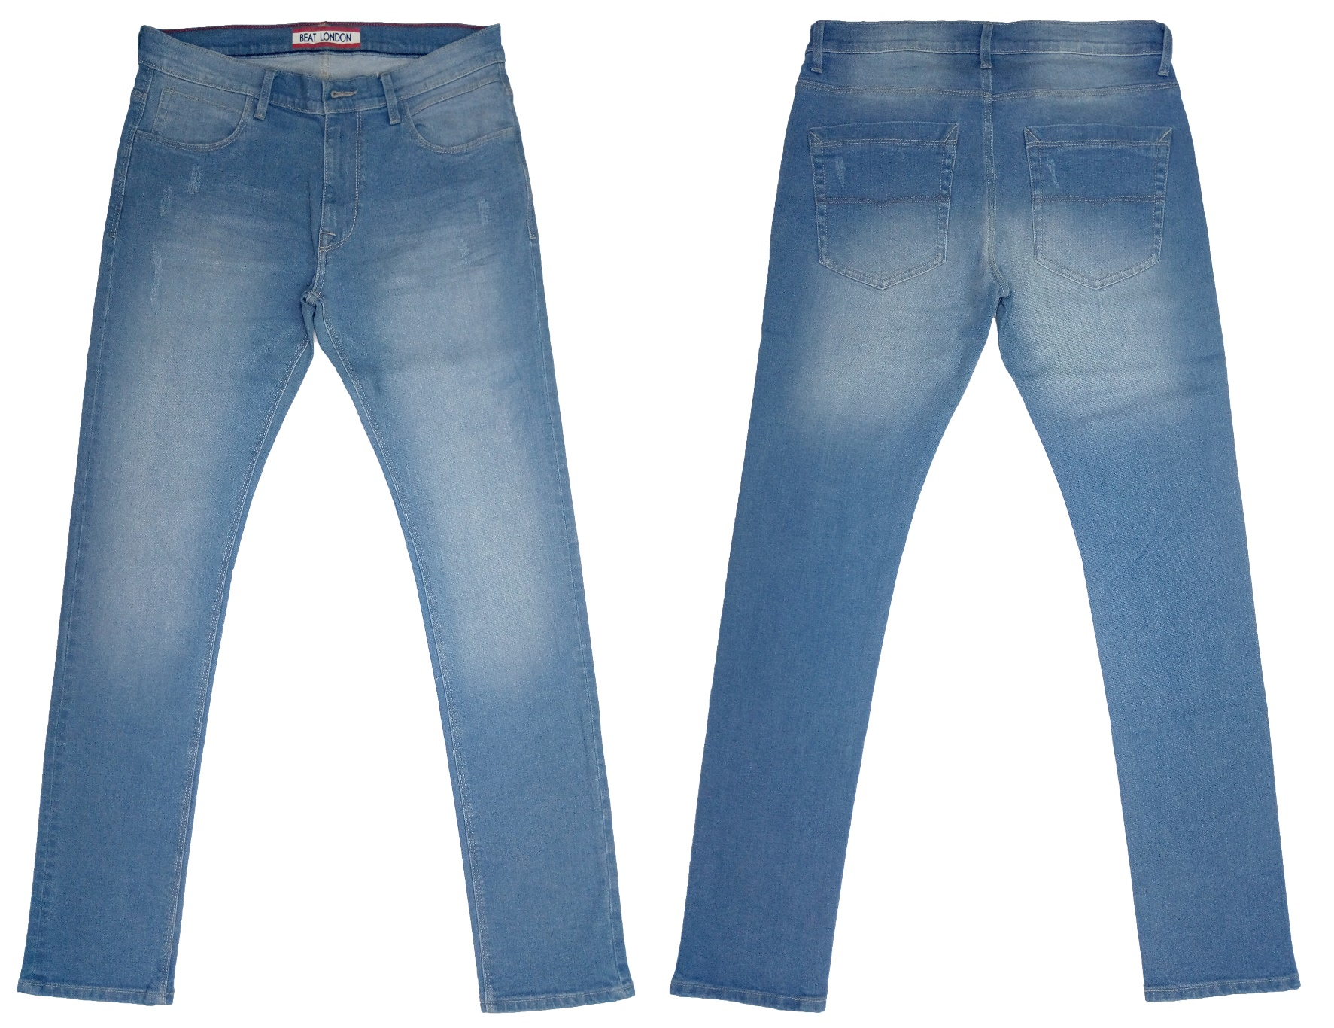
Buyer : PEPE JEANS
Brand : BEAT LONDON
Style : BL - OP04 -Q (COS-1198)
Fabrication : 98% Cotton 2% Spandex Dk. Denim FAB PRX: $2.35/YDS
Wash : Gesize, Enzyme, Bleach with Dry Process & RiP FOB: $7.90

Slide 12
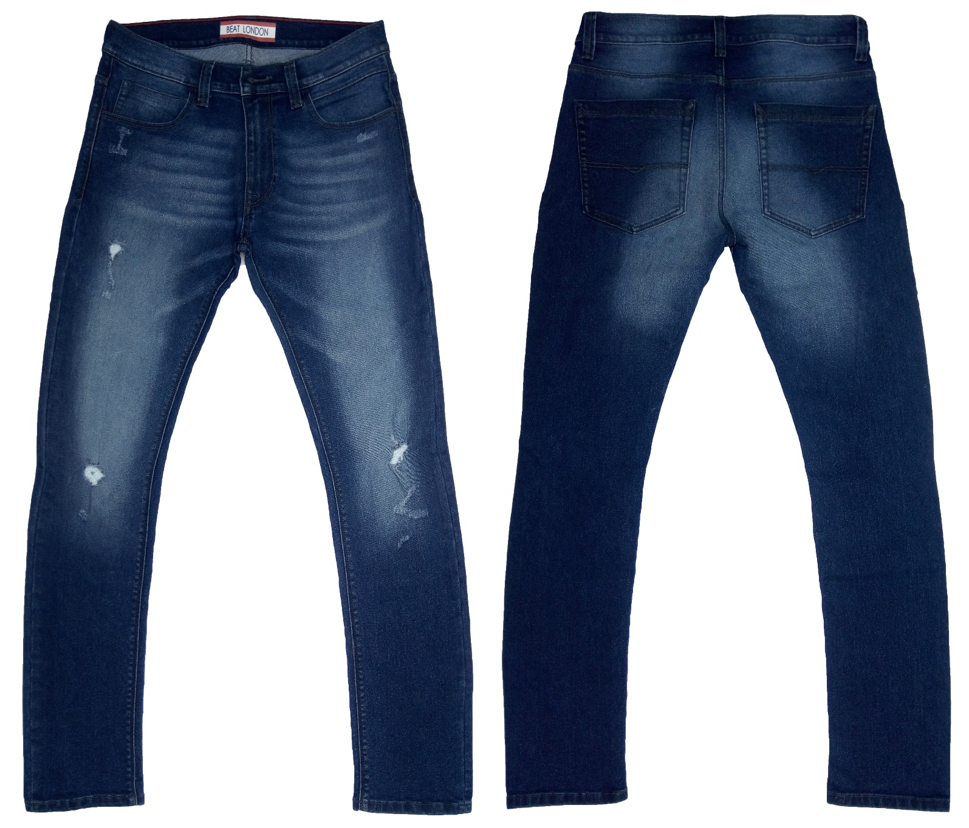
Buyer : PEPE JEANS
Brand : BEAT LONDON
Style : BL - OP04 -E (COS-1195)
Fabrication : 76% Cotton 22% Poly 2% Spandex Denim . FAB PRX: $2.30/YDS
Wash : Gesize, Enzyme, Bleach with Dry Process & Rip FOB: $7.95

Slide 13
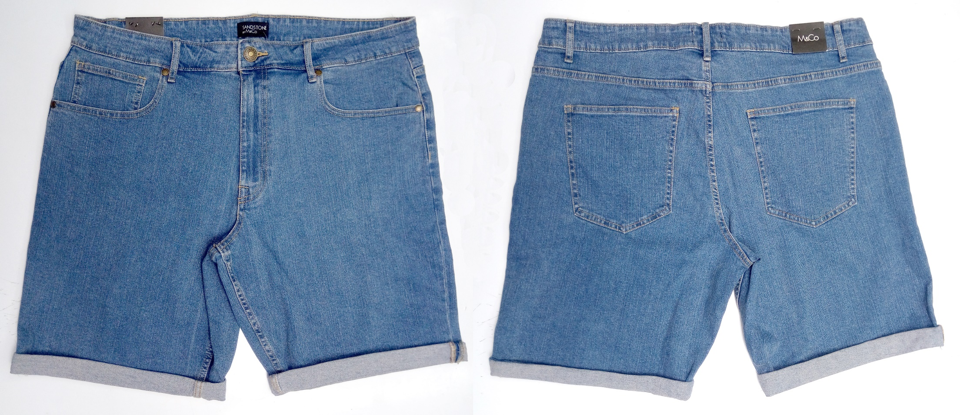
Buyer : MACKAYS Brand : M&Co
Style : Men's Denim Short
Fabrication : 98% Cotton 2% Spandex FAB PRICE: $2.85/YDS
Wash : Enzyme, Bleach With Tint FOB: $6.80

Slide 14
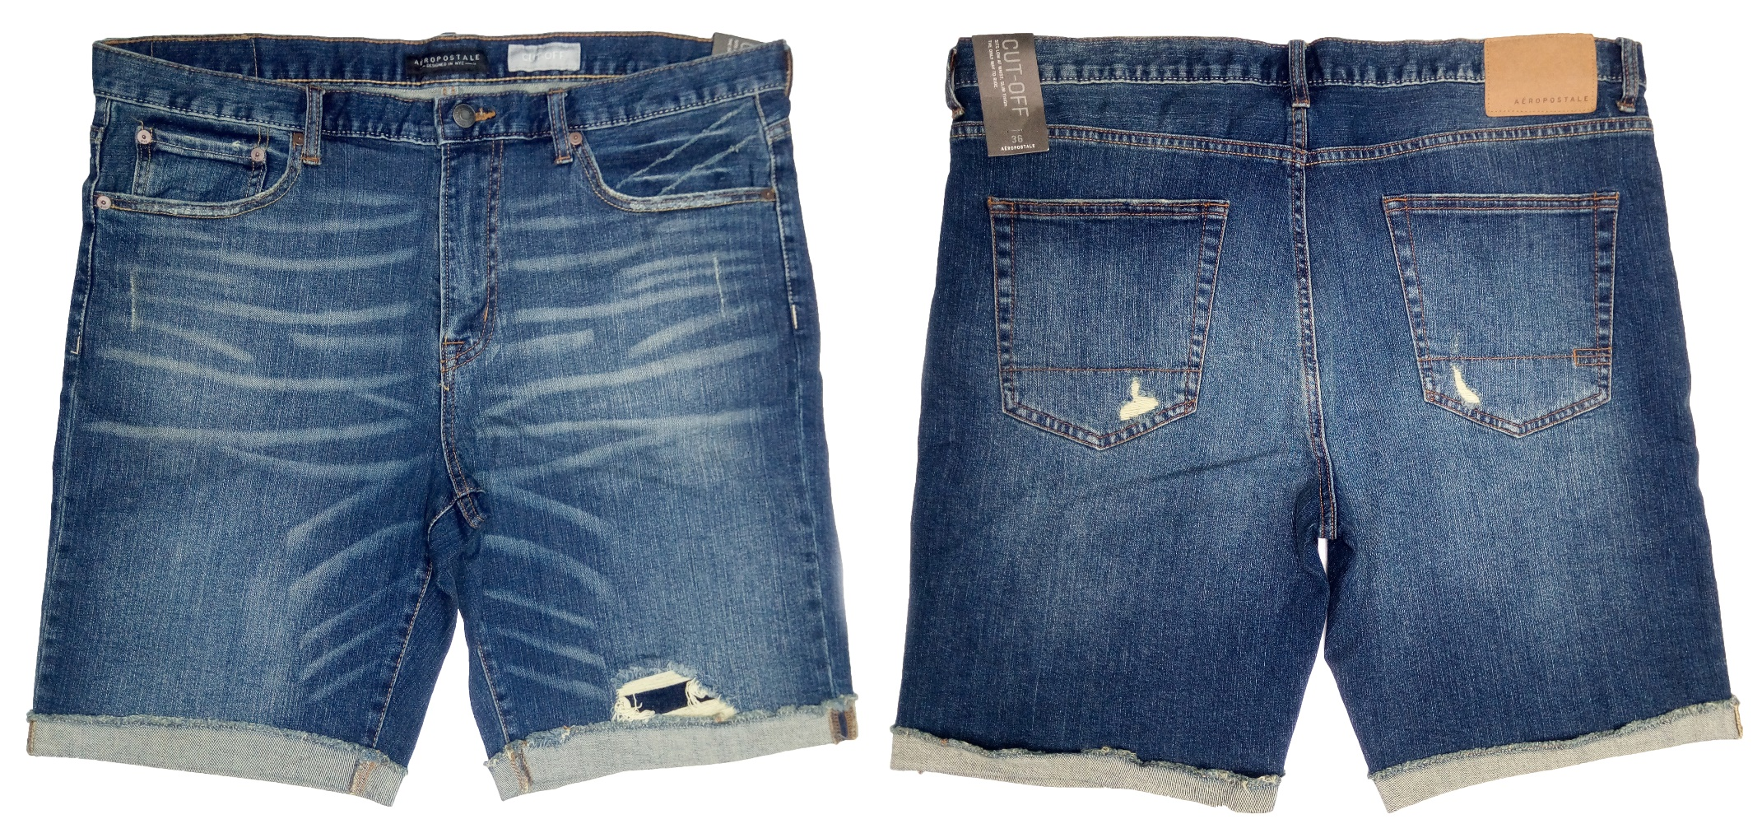
Buyer : AEROPOSTALE
Brand : AEROPOSTALE
Style : 1260
Fabrication : 98% Cotton 2% Spandex FAB PRICE: $3.15/YDS
Wash : Enzyme, Bleach With Dry Process & Rip FOB: $7.90

Slide 15
WOMENS COLLECTION

Slide 16
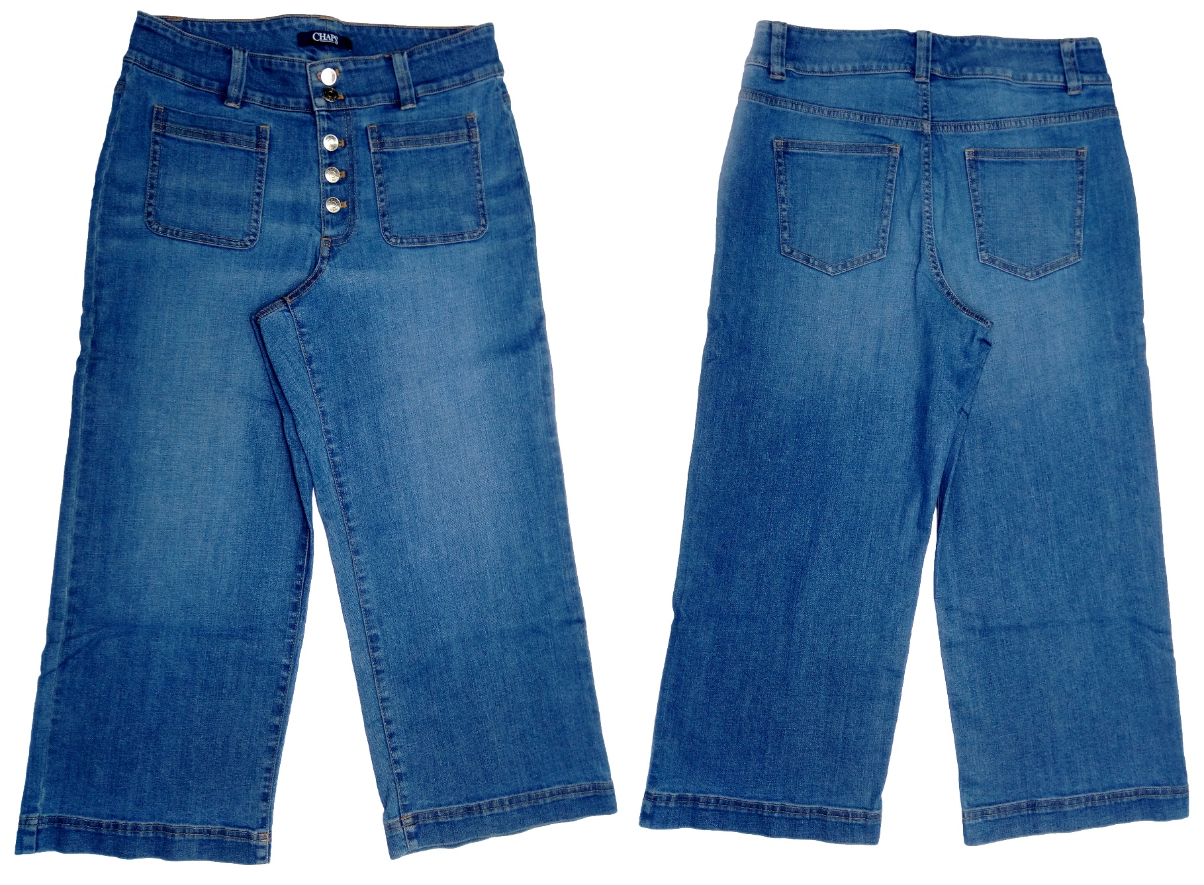
Buyer : RALPH LAUREN
Brand : CHAPS
Style : B2010C25R
Fabrication : 85% Cotton 13% Poly 1% Spandex . Fab prx: $2.92/yds
Wash : Pier Wash FOB: $10.79

Slide 17
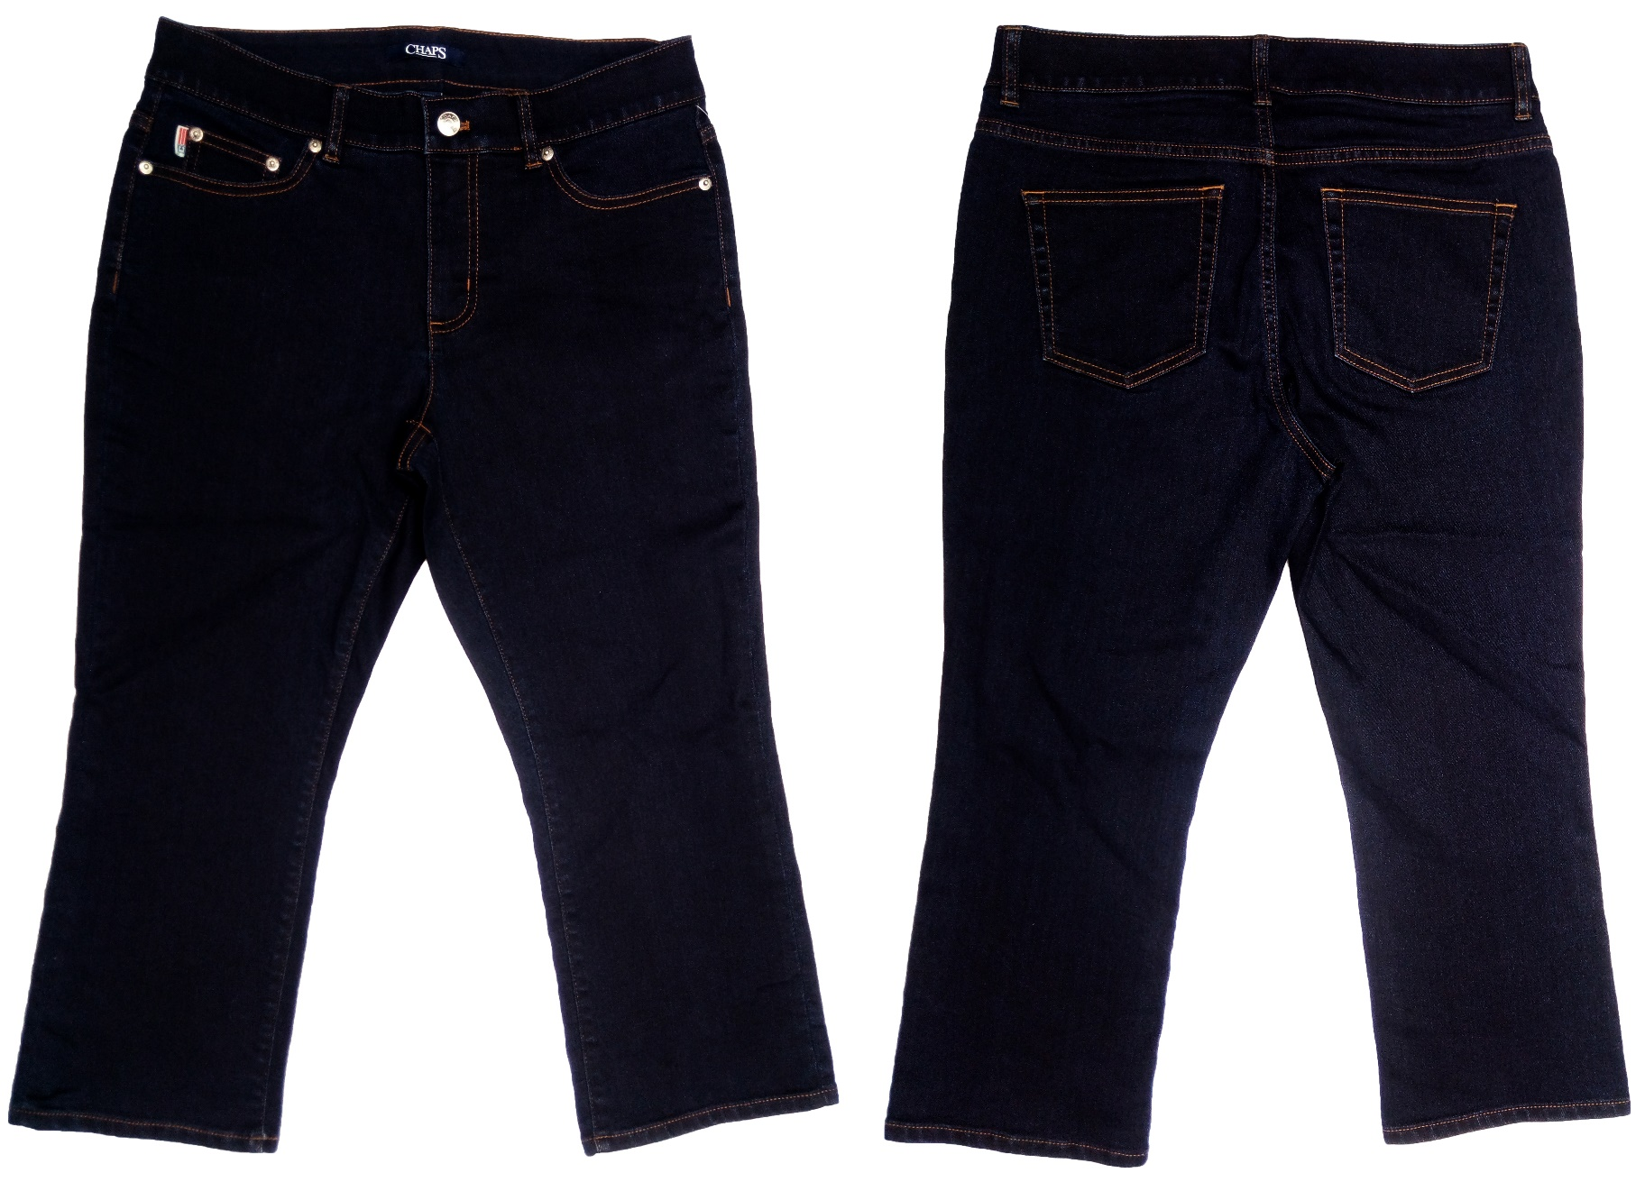
Buyer : RALPH LAUREN
Brand : CHAPS
Style : B2010C35X
Fabrication : 57% Cotton 25% Viscose 17% Poly 1% Spandex fab prx: $2.71/yds
Wash : New Dark Rinse Wash . Fob: $8.58

Slide 18
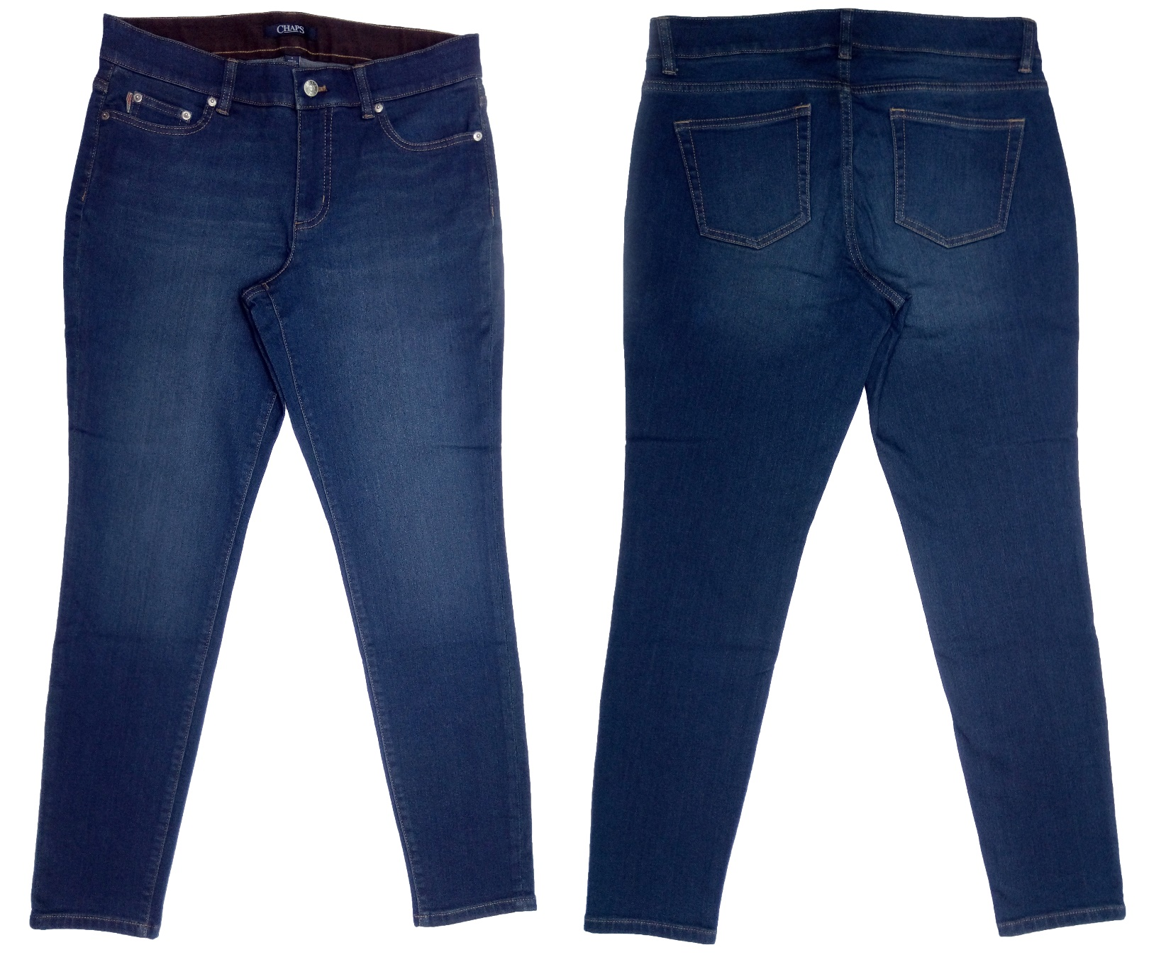
Buyer : RALPH LAUREN
Brand : CHAPS
Style : B191015W
Fabrication : 52% Cotton 25% Viscose 18% Poly 1% Spandex fab prx: $2.85/yds
Wash : Bedford Wash fob: $8.58

Slide 19
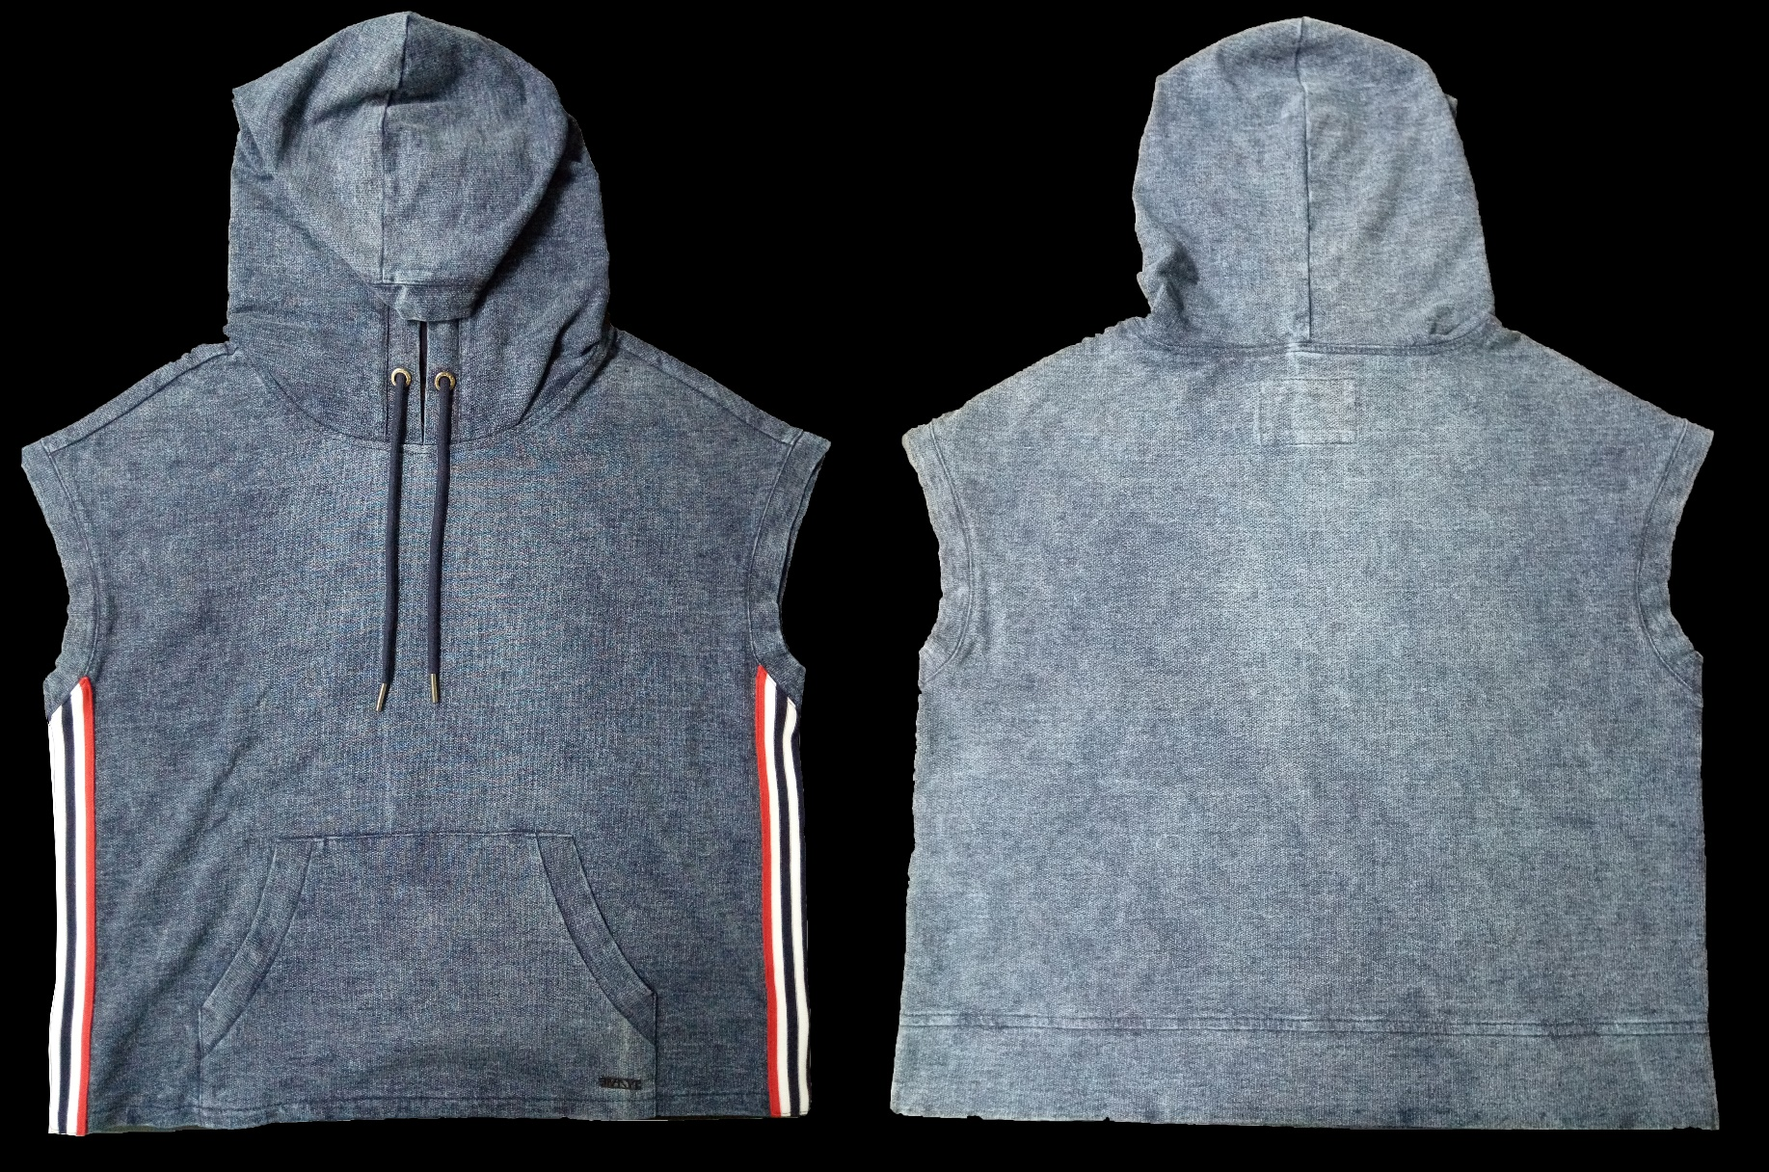
Buyer : G-III
Brand : MNY
Style : MN8T9771
Fabrication : 95% Cotton 5% Spandex Knit French Terry with INDIGO DYE. FAB PRX: $4.00/YDS
Wash : ACID WASH FOB: $9.85

Slide 20
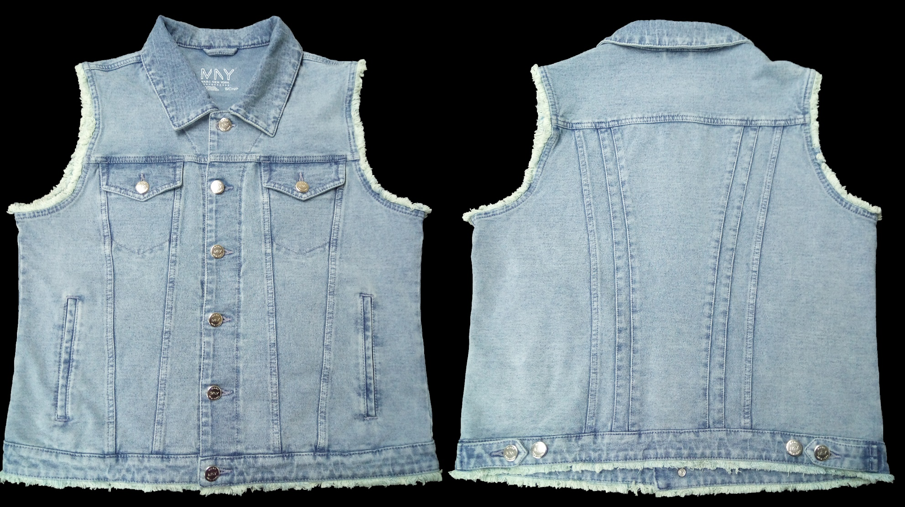
Buyer : G-III
Brand : MNY
Style : MN8V1583
Fabrication : 95% Cotton 5% Spandex Knit French Terry with INDIGO DYE. FAB PRX: 4.00/YDS
Wash : ACID WASH (LIGHT) FOB: $9.70

Slide 21
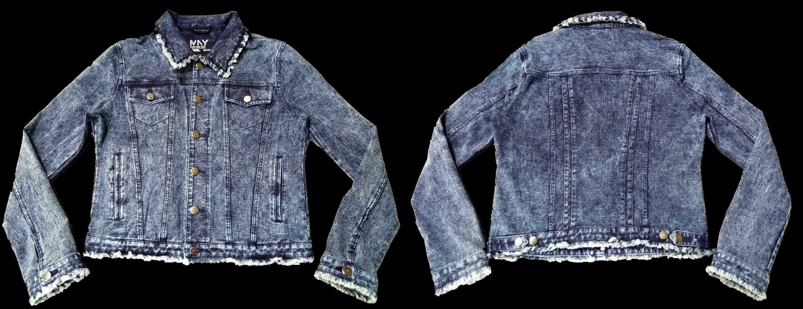
Buyer : G-III
Brand : MNY
Style : MN8J4438
Fabrication : 95% Cotton 5% Spandex Knit French Terry with INDIGO DYE. FAB PRICE: $4.00/YDS
Wash : ACID WASH FOB: $10.75

